Slide 1
UNIVERSITY OF MINES AND TECHNOLOGY (UMaT)
Faculty of Computing and Mathematical Sciences
Department of Computer Science and Engineering
STADIUM NETWORK SECURITY ASSESSMENT
A Comprehensive Security Report on Perimeter Identification, Network Infrastructure, and Human Operational Factors
February 2026 | Tarkwa, Ghana

Slide 2
GROUP MEMBERS
Sulemana Akunatu Abdul Jalil
Mushinat Mukaila
FCM.41.018.245.23
FCM.41.018.179.23
Mohammed Abdallah
Adu Martin Yeboah
FCM.41.018.175.23
FCM.41.018.013.23
Arthur Fosu Samuel
Ernest Dadzie
FCM.41.018.070.23
FCM.41.018.118.23
Narteh Benjamin Kwame Tei
Danso Adobea Josephine
FCM.41.018.183.23
FCM.41.018.120.23
Osei Michael Nyamekye
FCM.41.018.218.23

Slide 3
EXECUTIVE SUMMARY
This report presents a network security assessment for a 20,000-capacity stadium. It covers three main areas: the physical and logical security perimeter, the wireless network boundary, and human factors that could affect security.
Physical Perimeter
Wireless Network
Human Factors
Ten security zones with risk levels and access controls
Boundary control, VLAN design, and rogue AP detection
Social engineering threats and staff trust classification
Recommendations based on three security layers: physical protection, network control, and human awareness.

Slide 4
SECTION 1
Perimeter Identification

Slide 5
1.1 PHYSICAL PERIMETER DEFINITION
Visible Physical Boundaries
Invisible Logical Boundaries
Stadium outer fence and walls
Parking lot barriers at all vehicle entry points
Security checkpoints at all entry gates
Ticket control points at spectator entrances
Main stadium gates with security guards on patrol
Wireless network coverage limits — signals must not go outside the stadium
CCTV monitoring zones covering all areas
Network firewall boundaries separating all security zones
Security patrol areas monitored by the control room

Slide 6
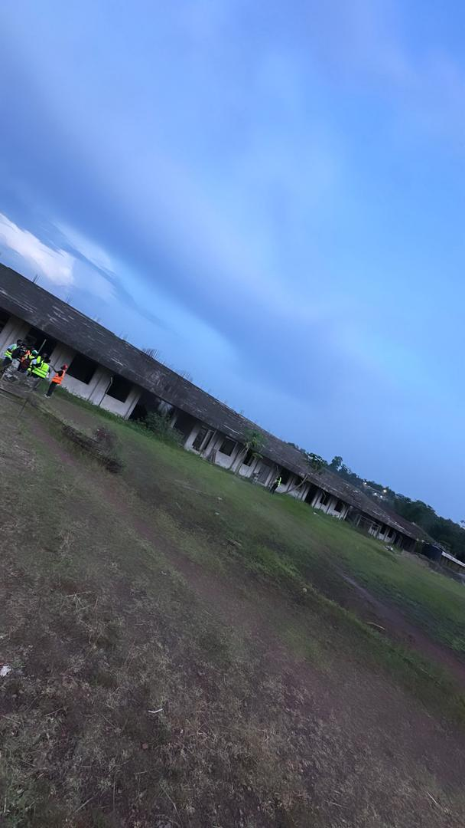
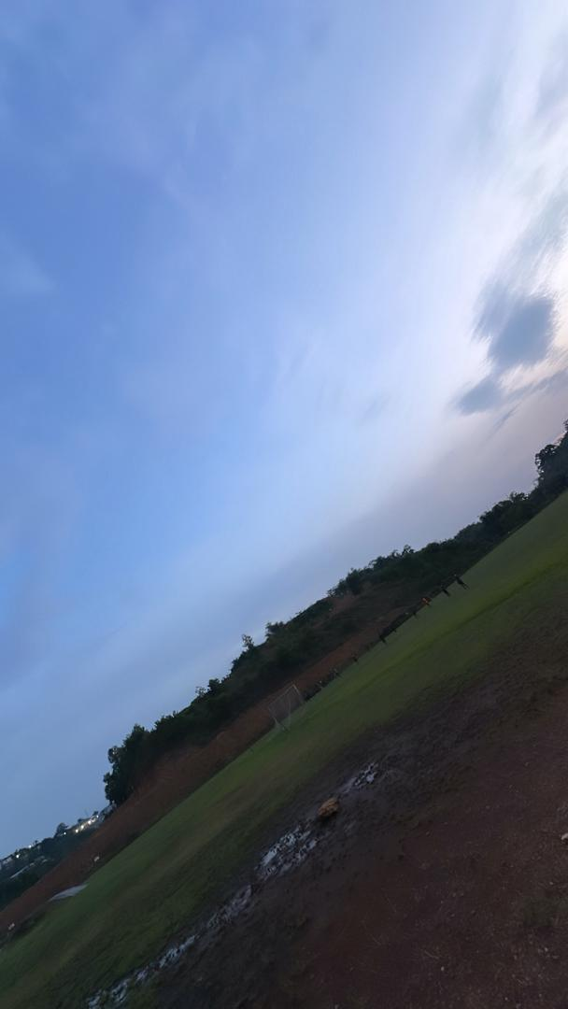
FIGURE 1: SITE VISIT PHOTOS — STADIUM FACILITY
Site visit photo 1 — Stadium perimeter & grounds
Site visit photo 2 — Playing field & surrounding area

Slide 7
1.2 SECURITY ZONE CLASSIFICATION
Zone | Name | Authorized Personnel | Risk Level
Z1 | Public Forecourt | General public | LOW
Z2 | Ticketed Concourse | Ticket holders, stewards | MEDIUM
Z3 | Seating Bowl | Ticket holders, stewards | MEDIUM
Z4 | VIP / Hospitality | VIP guests, hospitality staff | MEDIUM
Z5 | Media / Press Box | Accredited media, IT staff | HIGH
Z6 | Operations Control Room | Authorized operations staff | CRITICAL
Z7 | Server Room / NOC | IT and security staff only | CRITICAL
Z8 | Playing Field | Teams, officials, authorized staff | HIGH
Z9 | Perimeter Service Road | Vendors, emergency services | HIGH
Z10 | Parking Areas | Ticket holders, badged staff | MEDIUM

Slide 8
1.3 ENTRY POINTS AND ACCESS CONTROL
Pedestrian Entry Gates
Vehicle Entry Points
Gates A, B, C Main gates for majority of spectators
Gates D, E, F, G Secondary gates for additional access
Gate H Emergency egress only; not used for standard entry
V1 North Primary access for VIP and official vehicles
V2 South Service Gate Vendor, catering, and delivery vehicles
V3 Emergency Access West Reserved for emergency services
Access Control Technologies by Zone
Zone | Primary Control | Secondary Control
Z1 — Public Forecourt | None (open public access) | Uniformed steward patrols
Z2 — Ticketed Concourse | Barcode / NFC ticket scanning at turnstile | Visual bag search by stewards
Z4 — VIP Hospitality | RFID smart card + PIN keypad | Biometric fingerprint scan
Z6 — Control Room | RFID card + biometric fingerprint | Video intercom, guard approval
Z7 — Server Room / NOC | Iris scan + PIN + RFID card (3-factor) | Mantrap airlock — single occupancy

Slide 9
1.4 HIGHEST RISK ACCESS POINTS
Gate A — North Main Entrance
V2 — South Service Gate
Z7 — Server Room / NOC
CRITICAL
CRITICAL
CRITICAL
Busiest entrance, high crowd density. Risk of ticket fraud and crowd surge. Requires multiple ticket scanners, CCTV, and metal detectors.
All vendor/delivery vehicles use this gate. Fake deliveries can smuggle unauthorized people or dangerous devices. All deliveries must be pre-registered.
Controls entire stadium network including cameras, PA system, and emergency comms. Requires three-factor authentication and security door.
Gate G — Media West
V3 — Emergency Access West
HIGH
HIGH
Media passes are easy to copy. Camera bags can hide unauthorized devices. All media credentials and equipment must be checked before entry.
Opened on request with a key. Attacker can impersonate emergency services. Guards must verify callouts with control room before opening.

Slide 10
1.5 SURVEILLANCE AND MONITORING (266 CAMERAS)
Location | Qty | Camera Type | Function | Classification
Entry Gates (A–D) | 24 | Fixed 4K bullet | Entry monitoring | PREVENTIVE
Forecourts (all sides) | 16 | PTZ dome 4K | Crowd monitoring | PREVENTIVE
Concourse (all levels) | 60 | Fisheye 360° | Full coverage | DETECTIVE
Seating Bowl | 20 | PTZ long-range | Crowd detection | DETECTIVE
NOC / Server Room | 8 | Fixed 4K internal | Physical security | DETECTIVE
Parking Areas | 30 | PTZ + pole-mounted | Vehicle monitoring | CORRECTIVE
Emergency Exits | 24 | Sensor-triggered | Door alarm coverage | CORRECTIVE
Stairwells | 40 | Fixed 2MP dome | Flow monitoring | DETECTIVE
Vehicle Checkpoints | 18 | ANPR + overview | Plate recognition | PREVENTIVE
Roof / Plant Access | 12 | Motion-activated | Intrusion detection | DETECTIVE
VIP Suite Corridors | 8 | Fixed 4K dome | Access monitoring | DETECTIVE
Perimeter Service Road | 6 | PTZ wide-angle | Vehicle & staff checks | DETECTIVE

Slide 11
1.5 BLIND SPOTS & LIGHTING STANDARDS
Identified Blind Spots
Lighting Standards
Behind pillars — add cameras at base of each pillar
Bathroom entrances — wide-angle cameras in leading corridors
Under vehicle areas at entry gates — use mirror scanners
Rooftop areas — motion-activated cameras on maintenance walkways
Emergency exit exteriors — cameras covering area around every emergency door
Parking lots
Entry gates and concourse areas
Emergency exits and hallways
Staircases and restricted zone corridors
Server room and NOC

Slide 12
SECTION 2
Network and Wireless Perimeter

Slide 13
2.1 NETWORK INFRASTRUCTURE — VLAN DESIGN
VLAN ID | Name | IP Subnet | Purpose
10 | IT Management | 10.0.10.0/24 | NOC and IT staff management access
20 | Staff WiFi | 10.0.20.0/23 | All operational staff wireless access
30 | Operations | 10.0.30.0/24 | Control room and operations systems
40 | Media | 10.0.40.0/24 | Broadcast and press equipment
50 | Point of Sale | 10.0.50.0/24 | Retail and catering POS terminals (PCI-DSS scoped)
60 | Emergency | 10.0.60.0/24 | Emergency services communications
70 | CCTV | 10.0.70.0/24 | All surveillance cameras and NVRs
80 | VoIP | 10.0.80.0/24 | Internal telephony and PA systems
100 | Public WIFI | 192.168.100.0/22 | Fan-facing public hotspot (Internet only)
200 | DMZ | 172.16.200.0/24 | Public-facing servers (ticketing, web)
999 | Blackhole | N/A | All unauthorized/unrecognized device traffic dropped here

Slide 14
2.2 WIRELESS SIGNAL BOUNDARY MANAGEMENT
Signal Containment Methods
WiFi Signal Spillover Risk by Zone
Directional antennas point signals inward, away from streets
Transmit power is reduced to the minimum needed
WPA3 encryption enabled on all staff wireless networks
Staff network names are hidden — not visible when scanning for networks
MAC address filtering used to block unknown devices
Wireless Intrusion Detection System (WIDS) deployed
Regular network scanning to detect any unauthorized access points
Zone | Risk | Mitigation
North Forecourt (Z1) | HIGH | Directional antennas + TPC reduction
Parking Areas (Z10) | MEDIUM | Pole-mounted APs with inward antennas
VIP Suite Windows | HIGH | RF shielding film on external windows
Rooftop Plant Area | LOW | Minimal AP presence; motion-triggered only

Slide 15
2.3 ROGUE ACCESS POINT DETECTION & RESPONSE
Rogue Detection via Infrastructure
Wired Rogue Device Detection
Public WiFi Security Controls
All access points scan for unknown or suspicious networks while still serving users
Any network pretending to be the official WiFi is automatically blocked
Alerts sent to the NOC immediately upon detection
Unused network ports are disabled to prevent unauthorized connections
All devices connecting to the network are verified before access is granted
Any unrecognized device generates an alert and is blocked
All switch ports with no active device are disabled
Public WiFi on separate guest network (VLAN 100), isolated from staff systems
Every public user must accept terms of service before browsing
Bandwidth limited per device; firewall filters harmful websites
Client isolation enforced — fans cannot reach other devices

Slide 16
SECTION 3
Human Operational Factors

Slide 17
3.1 ACTOR CLASSIFICATION AND NETWORK TRUST LEVELS
Actor Type | Zone Access | VLAN | Trust Level | Network Policy
General Spectators | Z1–Z3 | VLAN 100 | UNTRUSTED | Internet only, client isolation
VIP Guests | Z1–Z4 | VLAN 100 | LOW TRUST | Internet only, managed bandwidth
Stewards | Z1–Z3, Z8 | VLAN 20 | MEDIUM | Event systems only
Operations Staff | Z2–Z6, Z9 | VLAN 30 | TRUSTED | Operations network, wired preferred
IT / NOC Staff | All zones | VLAN 10 | HIGH TRUST | Full network access
Security Staff | All zones | VLAN 20+ | HIGH TRUST | CCTV and comms access
Media / Broadcast Crew | Z5, Z8 | VLAN 40 | MEDIUM | Media VLAN, outbound only
F&B Vendors | Z2, Z3 | VLAN 50 | LOW TRUST | POS terminals only
Contractors | Z9, limited | Isolated | UNTRUSTED | No general network access
Emergency Services | All zones | VLAN 60 | HIGH (vetted) | Emergency comms only
Delivery Drivers | Z9 only | None | UNTRUSTED | No network access granted

Slide 18
3.2 SOCIAL ENGINEERING THREAT ANALYSIS
CRITICAL
HIGH
HIGH
IT Staff Impersonation
Evil Twin WiFi Attack
Tailgating / Piggybacking
Attacker pretends to be IT technician, requests server room access. Staff may allow entry without verification.
Attacker creates a fake WiFi hotspot with the official stadium name. Spectators' passwords and payment details are stolen.
Unauthorized person follows staff member through secure door without showing credentials.
✔ ID badge checks, escort policy, NOC approval required.
✔ System auto-detects and blocks fake networks. Signs show real WiFi name.
✔ Security awareness training, one-person-at-a-time access doors, security guards.
CRITICAL
HIGH
HIGH
Vendor / Supply Chain Deception
Phishing Attack on Staff
Insider Threat
Fake delivery person arrives at service gate. Guard approves entry without proper checks.
Staff receive fake email asking to verify login via a link that steals credentials.
A staff member uses legitimate access to steal data, disable cameras, or allow unauthorized access.
✔ All deliveries pre-registered. Drivers must show photo ID. No unregistered vehicles allowed.
✔ Staff cybersecurity training, email filtering, multi-factor authentication (MFA).
✔ Role-based access, monitoring of unusual activity — large data transfers or after-hours access.

Slide 19
SECTION 4
Security Policy and Standards Alignment

Slide 20
4.1 STANDARDS AND FRAMEWORKS REFERENCED
Standard / Framework | Domain | Relevance
ISO/IEC 27001:2022 | Information Security Management | Overarching ISMS framework for all controls
NIST SP 800-53 Rev. 5 | Federal Security Controls | Access control, incident response, and audit
NIST SP 800-116 | Physical Access Control | PIV card and biometric access control design
NIST SP 800-153 | Wireless LAN Security | WiFi policy and rogue AP detection guidance
CIS Controls v8 | Cyber Hygiene | Controls 1–13 applied across network design
PCI-DSS v4.0 | Payment Card Security | VLAN 50 POS isolation and segmentation
BS EN 62676 | CCTV Standards | Camera specification and placement guidance
GDPR Article 6 | Data Protection | Lawful basis for biometric data processing
IEEE 802.11ax (Wi-Fi 6) | Wireless Standards | WPA3-Enterprise for all staff networks

Slide 21
4.2 KEY POLICY RECOMMENDATIONS
Access Control Policy
Network Security Policy
All access to zones Z5–Z7 must require at least two forms of authentication
No one allowed to enter server room or NOC alone
Access rights reviewed regularly; inactive accounts suspended
All access events recorded and kept for at least 12 months
No personal or unregistered device may connect without approval
All staff wireless connections must use WPA3 encryption
Public WiFi always kept separate from staff and operations networks
All new network equipment checked by IT before installation
Surveillance Policy
Incident Response Policy
All CCTV footage stored securely for at least 31 days
Access to footage restricted to authorized security and IT staff
Regular camera audits to check coverage and recording quality
CCTV use must comply with data protection laws
All incidents reported to NOC as soon as detected
Incident response plan in place and tested regularly
Security review completed after every major event
Staff must complete regular training, including social engineering awareness

Slide 22
4.3 RISK REGISTER SUMMARY
Risk | Category | Likelihood | Impact | Risk Level
Rogue AP / Evil Twin attack | Network | High | High | CRITICAL
IT staff impersonation | Human | Medium | High | CRITICAL
Fake vendor / supply chain | Physical | Medium | High | CRITICAL
Tailgating at secure doors | Physical | High | Medium | HIGH
Phishing targeting staff | Human | High | Medium | HIGH
Insider threat from staff | Human | Low | High | HIGH
WiFi signal spillover | Network | Medium | Medium | MEDIUM
Camera blind spots | Physical | Medium | Medium | MEDIUM
Counterfeit ticketing at gates | Physical | High | Low | MEDIUM

Slide 23
SECTION 5
Physical Access Control Mechanisms

Slide 24
SECTION 5: PHYSICAL ACCESS CONTROL MECHANISMS
5.1 ID Cards
5.2 Biometric Systems
RFID cards — scanned at a reader without needing to swipe or insert
Smart badges — store information about staff member and their access level
Fingerprint scanner — scans the person's fingerprint to confirm identity
Facial recognition — camera checks the person's face before allowing access
5.3 Electronic Locks
5.4 Turnstiles
Keypad locks — person enters a PIN code to unlock the door
RFID locks — door unlocks when authorized RFID card is held near reader
Installed at all spectator entrances to control flow of people
Each person must scan a valid ticket to pass through
Stops people from entering without a ticket; counts people inside

Slide 25
SECTION 6
Security Classification

Slide 26
SECTION 6: SECURITY CLASSIFICATION
6.1 Preventive Controls
6.2 Detective Controls
6.3 Corrective Controls
Measures that stop incidents from happening in the first place — put in place before any problem occurs.
Measures that identify and record incidents as they are happening — help security staff notice problems quickly.
Measures taken after an incident has occurred — help the stadium recover and prevent recurrence.
Access control systems — only allow authorized people into restricted areas
Security guards — visible presence that discourages unauthorized access
Perimeter fencing — physical barrier that prevents entry to wrong areas
Strong authentication — requires multiple steps to verify identity before access
CCTV cameras — record activity and alert staff to suspicious behaviour
Intrusion detection systems — detect unauthorized access attempts on the network
Security monitoring software — watches network traffic for unusual activity
Incident response team — trained staff who respond to security incidents
Alarm systems — alert staff and trigger response when breach is detected
Lockdown procedures — steps taken to secure stadium when serious threat detected
Backup systems — copies of important data kept safe for restoration after attack

Slide 27
SECTION 7
Network Architecture

Slide 28
SECTION 7: NETWORK ARCHITECTURE — THREE-LAYER DESIGN
7.1 Core Layer
7.2 Distribution Layer
7.3 Access Layer
1 Cisco Router — connects stadium network to the internet
1 Cisco Firewall — blocks unauthorized traffic; protects internal network
1 Cisco Core Switch — connects all distribution switches together
Switch 1 — Security systems network (CCTV, access control)
Switch 2 — Operations network (staff computers, control room)
Switch 3 — Public WiFi network (fan hotspots)
CCTV cameras
Access control systems (door scanners, turnstiles)
Ticket scanners at entry gates
Staff computers in offices and control rooms
Cisco wireless access points (staff and public WiFi)

Slide 29
7.4–7.6 NETWORK SEGMENTATION, WIRELESS & SECURITY DEVICES
7.4 Network Segmentation (VLANs)
7.5 Wireless Network (Access Point Locations)
VLAN 10 — Security Systems (CCTV cameras, access control devices)
VLAN 20 — Staff Network (staff computers, operations systems)
VLAN 30 — Media Network (broadcast equipment, press area)
VLAN 40 — Guest WiFi (public hotspots for fans — internet only)
VLAN 50 — Management Network (IT administrators only)
Seating areas — for fans watching the match
Concourse — for fans moving around the stadium
VIP areas — for VIP guests and hospitality staff
Media sections — for broadcast crews and journalists
All access points managed by Cisco Wireless LAN Controller (WLC).
7.6 Security Devices
Cisco Firewall — checks all traffic entering/leaving the network and blocks suspicious traffic
Intrusion Detection System (IDS) — monitors network and raises alarm if attack detected
Network Monitoring System — gives IT staff a clear view of all devices and traffic at all times

Slide 30
CONCLUSION
Physical Perimeter
Wireless Network
Social Engineering
Main gates, service gate, and NOC need strong physical and technical controls.
Must be managed to prevent signal leakage and rogue access points.
The hardest threat to defend against because it targets people, not technology.
The controls in this report work together to protect the stadium. No single measure is enough on its own. Physical security, network controls, and staff training must all be used together.
This assessment should be reviewed and updated every year, and whenever major changes are made to the stadium or its systems.

